Slide 1
Adversarial Search in Game Environments
Kenneth Willeford

Slide 2

Personal Background
Game Development
Poor Family
Carefully Picking Out Games
Game Reviews
Replayability
Adventure/RPG
RPG Maker
Make own games.
RGSS (Ruby Game Script System)

Slide 3
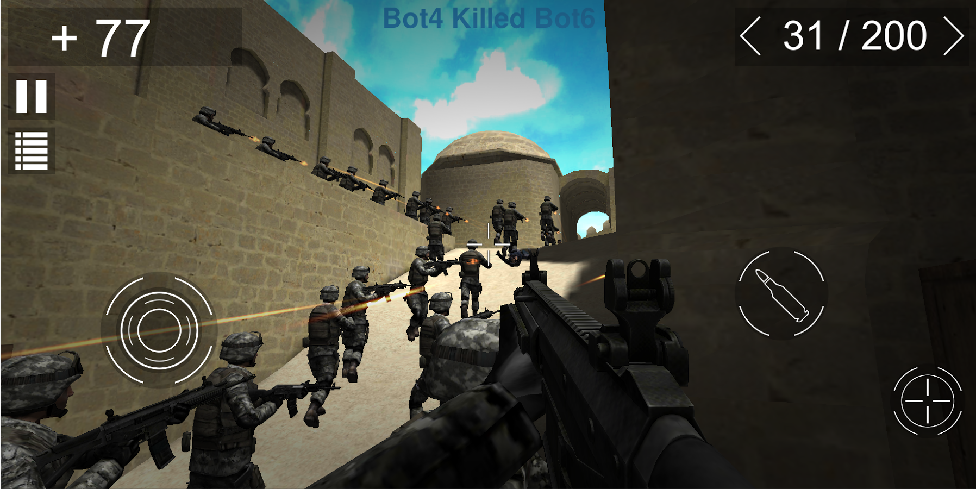
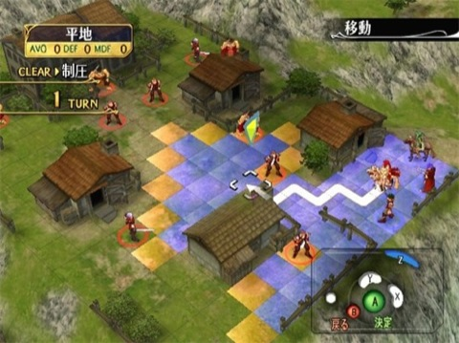
A.I and Games
Simple Reflex Agents
Hack and Slash
Shooters
Too many Agents…
Adversarial Agents
Fighters
Turn-Based Games
Only a few agents or time isn’t critical…
Computational Compromise
Pixel Perfect Action Infeasible
Grid Space and Cube Space
Commitment Periods

Slide 4
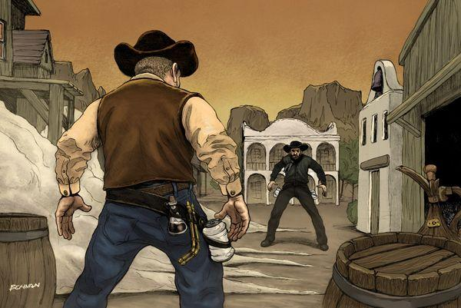
RPG Maker: Dueling AIs
Explore Agent Behavior in Expectimax and Minimax.
Important Differences
Agents require more than one hit to die.
Chance to learn from mistakes.
Competing agents are on equal ground.
Possibly multiple utility functions.
Abstract Behavioral Patterns?

Slide 5
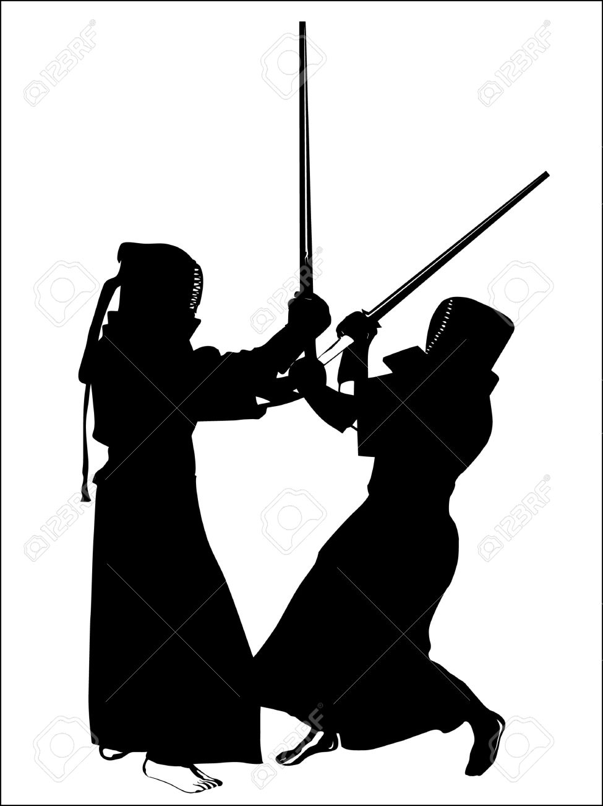

Performance Measure
Rational Thought and Action
It’s better to have more HP.
It’s better to reduce enemy HP.
Maximizing my health and minimizing the enemy’s health is best.
Humanly Thought and Action
The importance of Attacking/Defending is relative.
If my health is low and the enemy’s is high I should avoid all damage and look for an opening.
If my opponent is weak I should go for a finishing blow regardless of the damage I take.

Slide 6
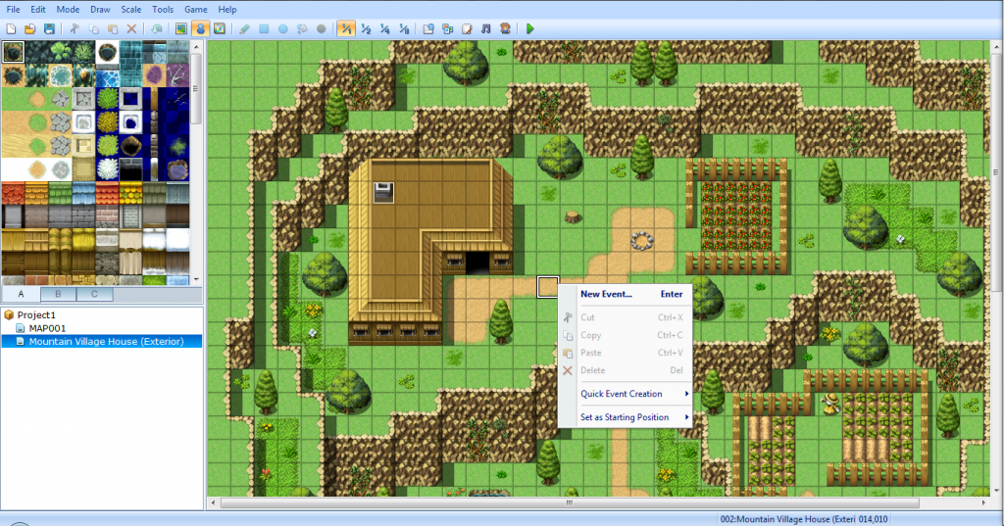
Environment
Grid Space
RPG World
Stats
Arbitrary Open Space
Impassable objects?
Grid Search
Manhattan Distance
Falcao ABS
Coupling to Actuators
Coupling to Sensors

Slide 7
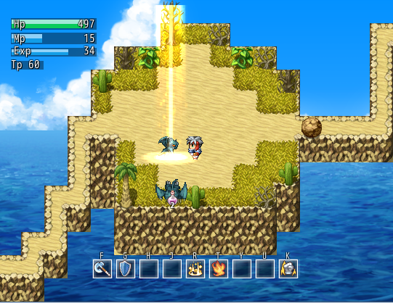
Actuators
Move Up/Down/Left/Right
Melee - Melee does 2 damage at a close range.
Guarding - Reduces damage by 1.
Projectile - Inflicts 1 damage at a distance.
Actions have cooldowns.
As it goes along there may be multiple options for a given actuator category.

Slide 8

Sensors
Fully Visible
Can View Each Other's Statistics
Know Each Other's Position
Know Each Other’s Actuator Statistics
Cooldowns
Damage Inflictable
Intentional Error?
Sensors are Restrictable
Approximations instead of Exact?
Humanly Thinking?

Slide 9
Adversarial Search Methods
Agent Position
‘Skill Statistics’
‘Psychological Factor’
Trial and Error Learning
Branching Factor is Minimum of 7
Keep game-ply to a minimum.
Test for good balance
Adversarial Search Methods Compared
Expectimax vs Expectimax
Minimax vs Minimax
Expectimax vs Minimax
Repeated with different behavioral patterns?..

Slide 10
Evaluation Ideas
Behavioral Searching
Preference of Actuators
Restriction of Sensors
Minimax vs Expectimax
Psychological Damage
Punished = Damage
Good = Reward
Simple Learning?
Behavioral Abstraction?
Safe Moves have positive utility.
Unsafe Moves have negative utility.
Decisive Moves have high positive utility.
Poort Moves have very negative utility.
Separation of Actuators into Classifications
Safety
Movement/Guarding
Aggressive
Melee/Projectile

Slide 11
Questions?

